Slide 1
A Machine Learning Review
- collaborative workshop
CAS ADS M5
University of Bern

Slide 2
Types of Data and Bias
Feature engineering
Machine Learning Definition(s) and Learning Paradigms
Tasks and Algorithms / Models
Performance Metrics
Each group gets one section and divides it into subsections among the group members. Each member works out slides (max 5-10 slides) and the group discusses internally their presentation (10+5 min). After the break we have the presentations
Notes:
Vorstellung Sukanya und Sigve, Umfrage

Slide 3
Types of Data
Structured data
Data organized in a fixed format, like rows and columns, typically stored in databases or spreadsheets
follows a strict pattern, making it easily searchable and analyzable, follows a standard order, which is highly organized
often numerical or categorical
hierarchical structure
clear categorization
Benefits: straightforward data management and analysis, compatible with most tools
Disadvantages: flexibility limitations due to rigid schema
Examples: financial data, customer information (names, addresses)
Notes:
easy to organize and maintain, simple to update and modify

Slide 4
Types of Data
Unstructured
No pre-defined format or organization, making it challenging to capture, process, and analyze.
Often consists of text and multimedia material.
Examples: Images, audio files, videos, text data (e.g., emails, tweets or PDF files).
→ Often requires advanced tools like AI/ML for processing.
Unstructured data provides deeper insights and context than structured data enhancing decision-making and predictive capabilities.

Slide 5
Types of Data
Semi-structured
Data that sort of have a structure, but does not fit into the traditional tabled databases. → XML, JSON
Contains tags and other markers to separate semantic elements and enforces a kind of hierarchy of the data.
Often contains metadata that describes the data itself.
Can be both read by humans and machines
Advantages:
Flexibility, Scalability, Easier to process than unstructured, Versatility
Disadvantage:
Complexity in Querying, Data quality, Storage, Integration issues

Slide 6

Types of Data: Metadata
Data about Data
Example: Photo
Metadata:
Date and Time
Location
Camera model
File size
Resolution
Example: Document
Metadata:
Author
File size
Format (pdf, word etc.)

Slide 7
Feature engineering
Numerical Transformations
Log Transformation
makes very large numbers closer to smaller ones
Categorical Encoding
One-Hot Encoding
turns categories into yes/no columns
computers can't understand words directly
Label Encoding
turns categories into numbers in order
some categories have natural progression

Slide 8
Feature engineering
Normalization
Rescaling features to fall between 0 and 1 to prevent some features to dominate over others
Example: Predicting housing prices given square footage (500 to 5000m²) and number of bedrooms (1 to 5)
The model might give more weight to square footage because its values are much larger, even if number of bedrooms is equally important.
After normalization (scaling both features to a range of 0–1):
Both features have equal influence, allowing the model to learn patterns more effectively.

Slide 9
Bias types
1. Selection Bias
Definition: the sample used for data collection is not representative of the population/problem being studied.
e.g. Sampling bias, exclusion bias, drop-out (attrition) bias (and many more)
Impact: Reduced model generalizability, Skewed insights, Ethical concerns
Prevention: Ensure Representative Sampling, Augment and Balance the Dataset, Continuously Audit and Validate Data.

Slide 10
Bias types
2. Sampling Bias
Definition: systematic error in collecting data where some members of the intended population have a higher or lower probability of being included in the sample than others,
leading to a non-representative sample of the population.
Examples:
Phone survey during working hours, working class might be underrepresented, while retired individuals or students may be overrepresented.
Conducting an online survey about internet usage (misses people without internet)
Impact:
Results don't represent the true population
Conclusions may be invalid or misleading
Policy decisions based on biased data may be ineffective
Research findings may not be generalizable
Prevention methods:
Random sampling
Accounting for non-responses

Slide 11
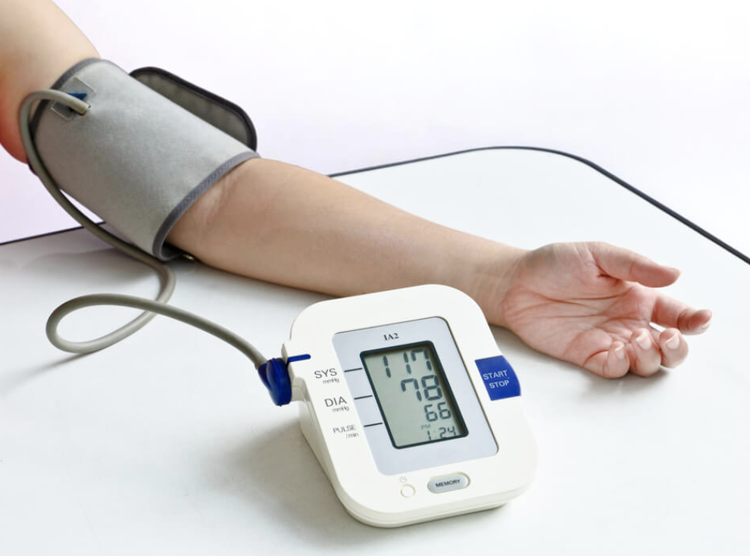

Bias types - Measurement Bias
Definition: Occurs when there is an error in how data is collected or measured, leading to systematic inaccuracies.
Example Blood pressure:
Wrongly calibrated Blood pressure device, all the values that are too high or too low
Blood pressure measurements taken prior to an exam, yielding values that are much higher than they’d be in a relaxed state

Slide 12
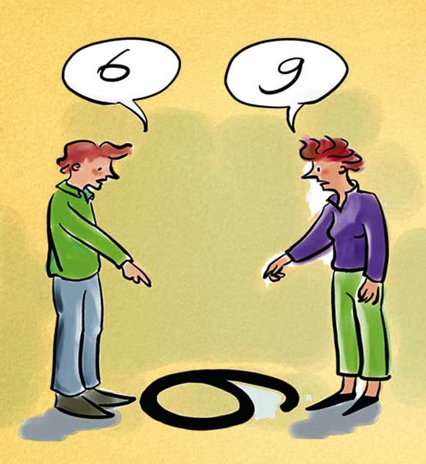
Bias types
Observer Bias
Definition: When the person collecting or observing data is influenced by their expectations or beliefs, which affects the results.
Example: If an interviewer expects certain results, they might unconsciously interpret ambiguous answers to fit those expectations.

Slide 13
Machine Learning Definition and Learning Paradigms
Definition:
Branch of AI
System can learn pattern and make decision/prediction without explicit programming
Learn from data (e.g. using historical data to identify patterns)
Improving through experience (refine their accuracy with more training)
Automating decisions (tasks like classification, prediction, and clustering)
Backbone of intelligent applications (cybersecurity, healthcare, IoT, and business)

Slide 14
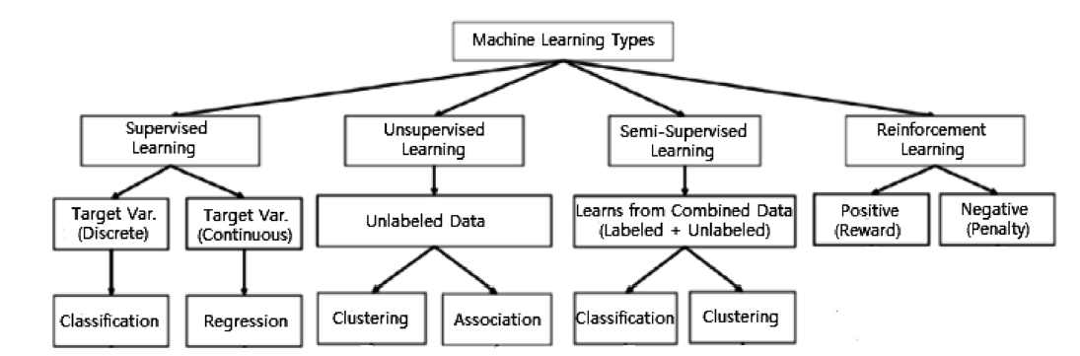
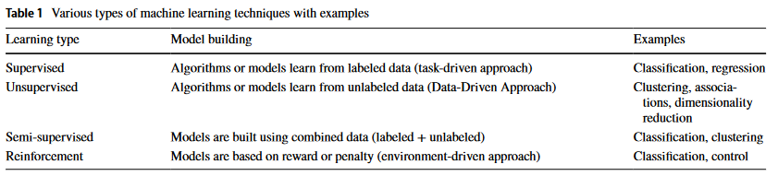
Machine Learning Definition and Learning Paradigms
Learning techniques (Sarker, 2021):
Supervised
Unsupervised
Semi-supervised
Reinforcement
Sarker, I. H. (2021). Machine learning: Algorithms, real-world applications and research directions. SN computer science, 2(3), 160.

Slide 15
Machine Learning Definition and Learning Paradigms
Supervised learning:
Supervised Learning:
Definition: Supervised learning relies on labeled datasets to train models to predict outcomes for unseen data.
Applications: Classification (e.g., spam detection), regression (e.g., house price prediction).
Examples of Algorithms:
Linear Regression
Support Vector Machines (SVM)
Decision Trees
Random Forest
Supervised learning is one of the most fundamental paradigms in machine learning. It involves training a model on a labeled dataset, where the input data has corresponding output labels. The goal of supervised learning is to learn a mapping function f:X→Yf: X \rightarrow Yf:X→Y, where XXX represents input features and YYY represents the target outputs.
Key Characteristics
Labeled Data: Supervised learning requires datasets where each input data point is paired with its corresponding label.
Task-Driven: Focused on specific tasks, such as classification and regression.
Error Minimization: The model iteratively learns by minimizing the error (or loss) between predicted outputs and actual labels.

Slide 16
Machine Learning Definition and Learning Paradigms
Supervised learning:
Types of Supervised Learning
Classification:
Objective: Predict discrete class labels.
Examples:
Spam email detection ("spam" or "not spam").
Image recognition (e.g., categorizing objects like "cat," "dog").
Popular Algorithms:
Naive Bayes: Assumes independence among predictors and uses Bayes' theorem for probabilistic classification.
Support Vector Machines (SVM): Finds the hyperplane that best separates classes in high-dimensional space.
Decision Trees: Uses a tree-like model for decision-making by splitting data into subsets based on feature values.
Random Forest: An ensemble of decision trees that improves accuracy by averaging results.
Regression:
Objective: Predict continuous numerical values.
Examples:
House price prediction based on features like size, location, and age.
Stock price forecasting.
Popular Algorithms:
Linear Regression: Fits a linear equation to the data.
Polynomial Regression: Extends linear regression to capture non-linear relationships.
LASSO and Ridge Regression: Add regularization to avoid overfitting.

Slide 17
Machine Learning Definition and Learning Paradigms
Supervised learning:
Workflow of Supervised Learning
Data Collection and Preparation:
Collect labeled data.
Clean the data to remove noise and handle missing values.
Split the data into training and testing sets.
Feature Engineering:
Select relevant features that influence the target output.
Transform features if needed (e.g., scaling, encoding categorical variables).
Model Training:
Train the model on the labeled dataset using a chosen algorithm.
Optimize the model parameters by minimizing the loss function.
Evaluation:
Test the model on unseen data (test set) to evaluate its performance.
Use metrics such as accuracy, precision, recall, F1-score (for classification), or Mean Squared Error (MSE) (for regression).
Tuning and Validation:
Fine-tune hyperparameters to improve model performance.
Use cross-validation to ensure robustness.
Advantages of Supervised Learning
Accurate Predictions: Often achieves high accuracy when sufficient labeled data is available.
Wide Applications: Used in fields like healthcare (disease diagnosis), finance (credit scoring), and e-commerce (product recommendations).
Interpretability: Models like linear regression or decision trees are easy to interpret.

Slide 18
Machine Learning Definition and Learning Paradigms
Supervised learning:
Challenges
Data Dependency:
Requires a large amount of high-quality labeled data, which can be expensive and time-consuming to collect.
Overfitting:
Models may perform well on training data but fail to generalize to unseen data.
Regularization techniques or pruning are needed to address this.
Bias-Variance Tradeoff:
Balancing model complexity to avoid underfitting (too simple) and overfitting (too complex).
Applications
Healthcare:
Predicting diseases based on patient data (e.g., diabetes prediction).
Finance:
Detecting fraudulent transactions in real time.
E-commerce:
Personalized product recommendations.
Natural Language Processing:
Sentiment analysis, text classification.
Supervised learning continues to be a cornerstone of machine learning due to its versatility and effectiveness in solving real-world problems when labeled data is available.

Slide 19
Machine Learning Definition and Learning Paradigms
Unsupervised learning:
Discovering patterns in unlabeled data
Identifying hidden structures and relationships
Common tasks / Applications:
Task | Explanation | Real-world example
Clustering | Grouping similar data points | Creating personas for marketing
Dimensionality reduction | Simplifying complex data Identify the most important dimensions (features) that explain the most variance in the data | Find that price and customer reviews are the two most important dimensions for predicting product sales in your company
Anomaly detection | Finding unusual data points | Early detection (and alert) of cyberattacks or data breaches

Slide 20
Machine Learning Definition and Learning Paradigms
Semi-supervised learning:
Uses a small amount of labeled data and a large amount of unlabeled data to train a machine learning model.
How does it work?
Assumptions:
Smoothness: Nearby points likely share the same label.
Clusters: Data naturally forms groups, and points in the same group share labels.
Manifold: Data lies on a lower-dimensional structure, and labels are consistent within this structure.
Techniques:
Self-training: Use the model to predict labels for unlabeled data, then retrain with these "pseudo-labels."
Graph-based: Spread labels from labeled to unlabeled points based on their similarity.
Consistency Regularization: Ensure predictions remain stable when data is slightly altered.

Slide 21
Machine Learning Definition and Learning Paradigms
Semi-supervised learning:
Applications
Medical Imaging: Predicting diseases with limited labeled scans.
Speech Recognition: Transcribing audio with minimal labeled data.
Fraud Detection: Identifying fraud with a few known examples.
Image Classification: Training with limited labeled photos.
Example In image classification:
Train on a few labeled images.
Use the model to confidently label additional images.
Retrain using these new pseudo-labels for better accuracy.

Slide 22
Machine Learning Definition and Learning Paradigms
Reinforcement learning:
Agent learns to make decisions by interacting with an environment and discovers what actions yield the highest rewards through trial and error - an environment driven approach.
An RL problem typically includes four elements such as Agent, Environment, Rewards, and Policy:
The agent observes a state, takes an action, receives a reward, and transitions to a new state.
Why use it?
Suitable for problems where outcomes depend on sequential decisions.
Effective in dynamic environments with delayed rewards.

Slide 23
Machine Learning Definition and Learning Paradigms
Reinforcement learning:
Key Methods
Model-Free RL: Learns directly from experience (e.g., Q-Learning, Deep Q-Networks).
Model-Based RL: Builds a model of the environment and uses it for planning.
Policy-Based RL: Directly optimizes the policy (e.g., REINFORCE, Proximal Policy Optimization).
Applications
Gaming: AlphaGo, OpenAI’s Dota 2 bot.
Robotics: Learning to walk, grasp objects, or navigate.
Autonomous Vehicles: Decision-making in dynamic traffic environments.
Healthcare: Optimizing treatment plans.
Finance: Portfolio optimization, trading strategies.

Slide 24
Tasks and Algorithms / Models
Classification Analysis
Key Machine Learning Tasks:
Classification: Predicts the class label (category) for given input data.
Regression: Predicts continuous values or quantities based on input data.
Clustering: Groups similar data points together without predefined labels (unsupervised learning).
Dimensionality Reduction: Reduces the number of input features, simplifying models and improving computational efficiency (e.g., Principal Component Analysis).
Deep Learning: A subset of machine learning using neural networks with many layers for tasks such as image recognition and natural language processing.
Generative Machine Learning (ML): refers to a category of AI systems designed to produce new content, such as text, images, music, video, or even code. Unlike traditional ML models that are focused on classification or prediction, generative models learn patterns in data to generate outputs that resemble the training data.

Slide 25
Regression Analysis
Regression Analysis: Predicting a continuous numeric value.
Example:
House Price Prediction: Predict the price of a house based on features like square footage, number of rooms, and location.
Stock Price Forecasting: Predict the future price of a stock based on historical data and economic indicators.
Weather Forecasting: Predict future temperature, rainfall, or wind speed based on historical weather data.

Slide 26
Binary Classification
Binary Classification: Predicting one of two class labels.
Example:
Spam vs. Not Spam: Classify emails as spam or not.
Medical Diagnosis: Predict whether a patient has a disease or not (e.g., cancer: yes or no).
Fraud Detection: Classify a transaction as "fraudulent" or "non-fraudulent".

Slide 27
Multi Class Classification
Multiclass Classification: Predicting one of multiple class labels.
Example:
Network Attack Types: Classify types of attacks (e.g., DoS, U2R, R2L, Probing) in cybersecurity datasets.
Animal Species Classification: Identify the species of an animal based on its features (e.g., lion, tiger, bear).
Sentiment Analysis: Classify movie reviews as positive, neutral, or negative.

Slide 28
Multi Label Classification
Multi-label Classification: Predicting multiple class labels simultaneously.
Example:
News Categorization: Classify a news article into multiple categories like "technology", "politics", and "sports".
Tagging Images: Label an image with multiple tags like "cat", "outdoors", "sunset".
Document Classification: Classify a document into topics such as "health", "finance", and "education".

Slide 29
Models
Logistic Regression (LR):
Uses a logistic/sigmoid function for classification.
Works well for linearly separable data.
Regularization helps avoid overfitting.
K-Nearest Neighbors (KNN):
Instance-based learning, no internal model, uses similarity measures.
Sensitive to data quality and requires optimal choice of neighbors.
Decision Tree (DT):
Non-parametric method that splits data based on feature values.
Criteria: Gini impurity, entropy (information gain).
Random Forest (RF):
Ensemble method combining multiple decision trees via bagging.
Reduces overfitting and improves prediction accuracy.
Extreme Gradient Boosting (XGBoost):
Advanced gradient boosting with second-order gradients for model optimization.
Handles large datasets and reduces overfitting.

Slide 30
Generative Machine Learning
refers to a category of AI systems designed to produce new content, such as text, images, music, video, or even code. Unlike traditional ML models that are focused on classification or prediction, generative models learn patterns in data to generate outputs that resemble the training data.
Key Features of Generative ML:
1. Creative Output: The primary purpose of generative models is to create novel content, not just analyze or categorize existing data.
2. Learning Data Distribution: Generative models learn the underlying probability distribution of the training data and use it to create similar, realistic outputs.
3. Versatility Across Modalities - these models are applied in domains such as:
• Text (e.g., ChatGPT, Bard)
• Images (e.g., DALL·E, Stable Diffusion)
• Audio (e.g., Jukebox by OpenAI)
• Video (e.g., generative video tools for special effects or synthetic media)

Slide 31
Generative Machine Learning
Common techniques include:
1. Generative Adversarial Networks (GANs):
• How it Works: GANs consist of two networks: a generator and a discriminator. The generator creates fake data, and the discriminator evaluates its authenticity. Over time, the generator improves until it can create data indistinguishable from the real data.
• Example: Generating realistic human faces or converting sketches into photorealistic images.
2. Variational Autoencoders (VAEs):
• How it Works: VAEs encode data into a compressed latent space and then decode it back to its original form. By sampling from this latent space, VAEs generate new data with similar characteristics.
• Example: Generating new designs for products or clothing.

Slide 32
Generative Machine Learning
Common techniques include:
3. Diffusion Models:
• How it Works: These models start with random noise and iteratively refine it to produce structured outputs. They have become popular for high-quality image and video generation.
• Example: DALL·E and Stable Diffusion generate images from text descriptions.
4. Transformer-Based Models:
• How it Works: Transformers process sequential data and learn complex relationships using attention mechanisms. Models like GPT (Generative Pre-trained Transformers) excel in natural language generation.
• Example: ChatGPT generates human-like text responses to prompts.

Slide 33
Performance metrics
Performance metrics: quantify performance of predictions made by ML models. Useful for model evaluation, comparison and improvement.
Performance metrics can be grouped in:
classification metrics
regression metrics
clustering
NLP / Images / Audio / Video

Slide 34
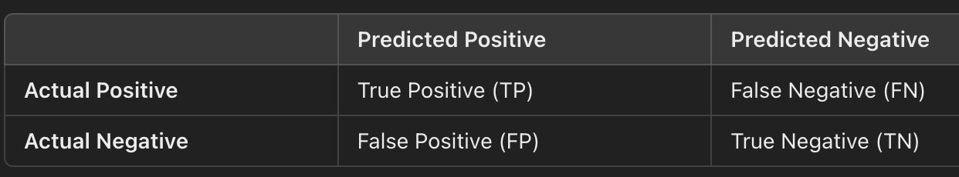
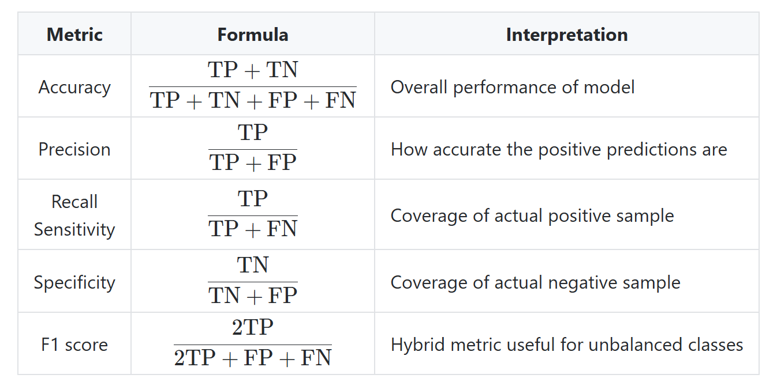
Performance metrics
Classification metrics
confusion matrix
main metrics
accuracy
precision
recall sensitivity
specificity
F1-score
ROC
AUC

Slide 35
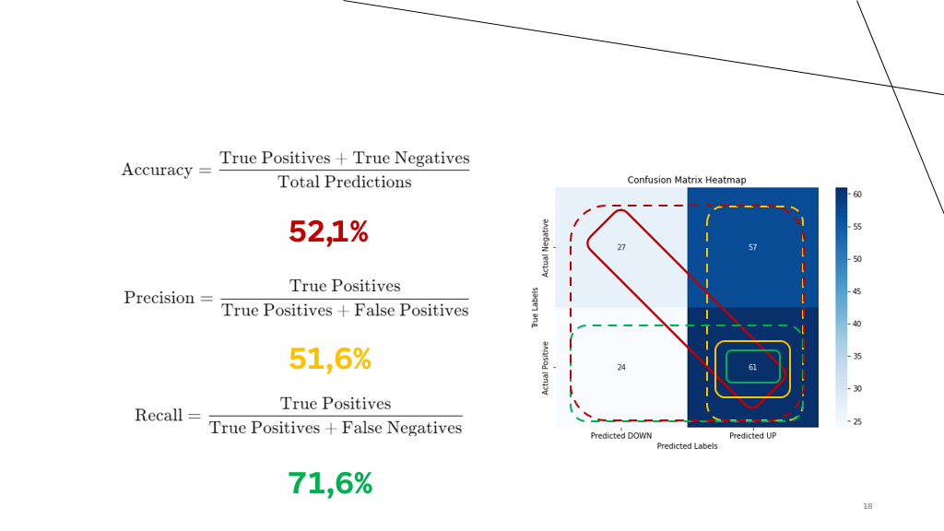
Classification tasks:
Random Forest
Logistic Regression
Decission Tree
K-Nearest neighbours
Notes:
Vorstellung Sukanya und Sigve, Umfrage

Slide 36
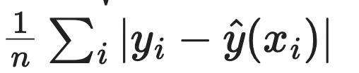
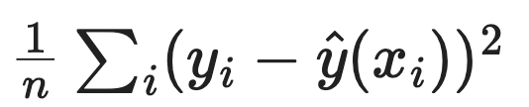
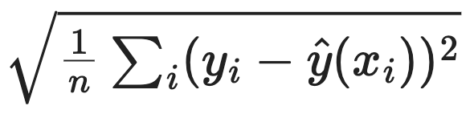
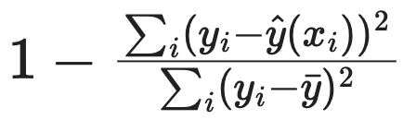
Performance metrics
Regression metrics
Mean Absolute Error (MAE)
Mean Squared Error (MSE)
Root Mean Squared Error (RMS)
Coefficient of determination (R2)

Slide 37
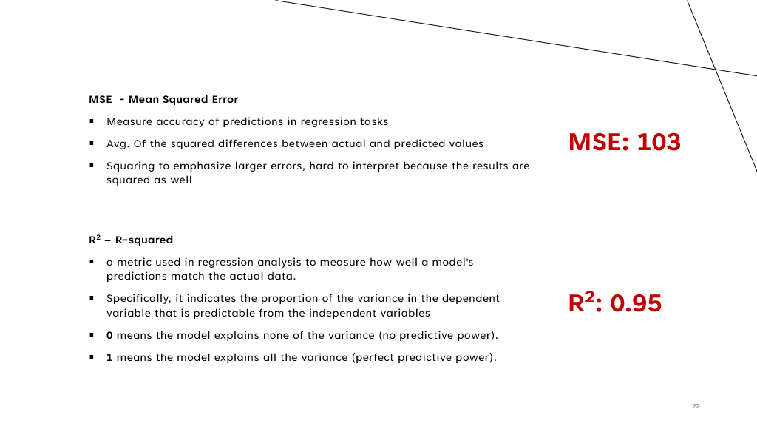
Regression tasks:
Linear Regression
Decision Tree (regression)
Random Forest Regressor
XGBoost
Notes:
Vorstellung Sukanya und Sigve, Umfrage

Slide 38
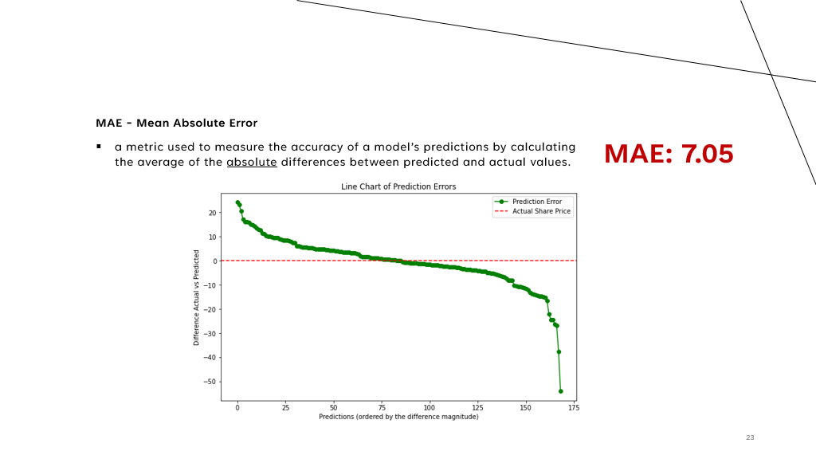
Notes:
Vorstellung Sukanya und Sigve, Umfrage

Slide 39
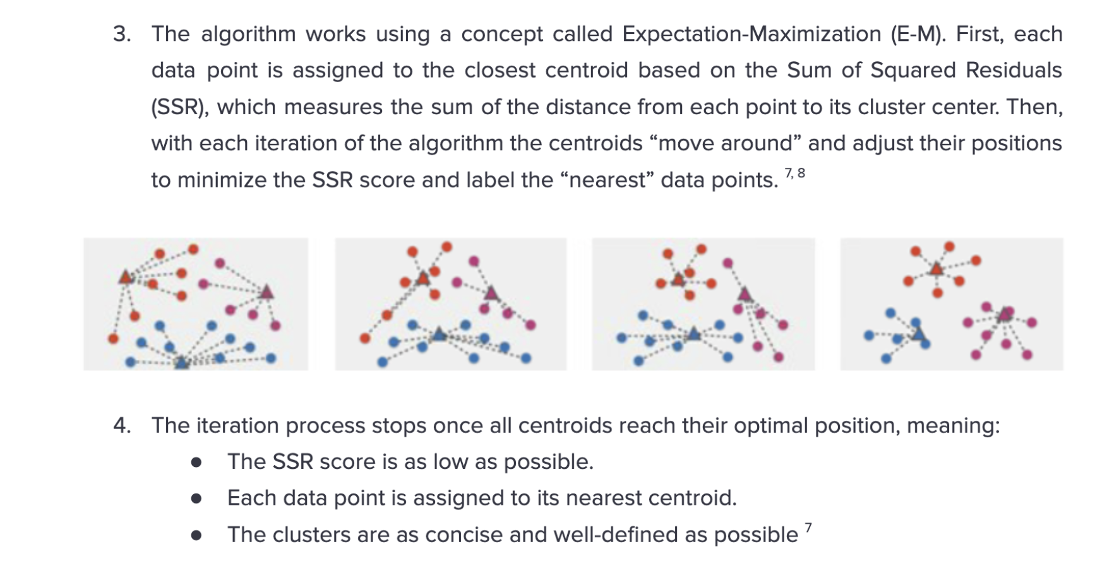
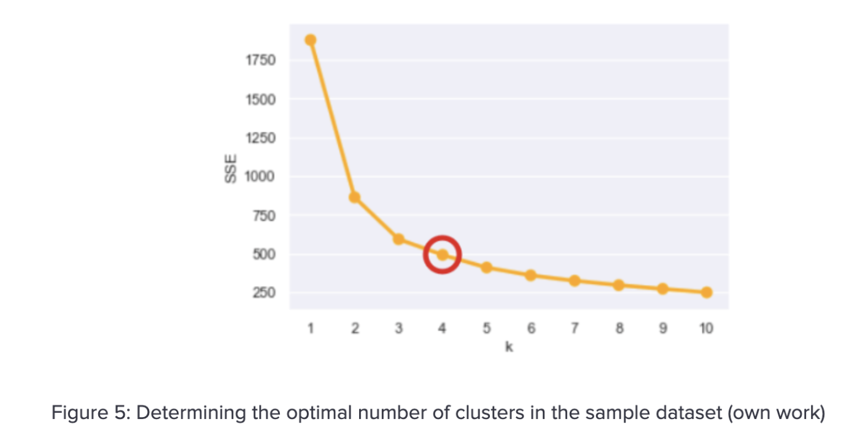
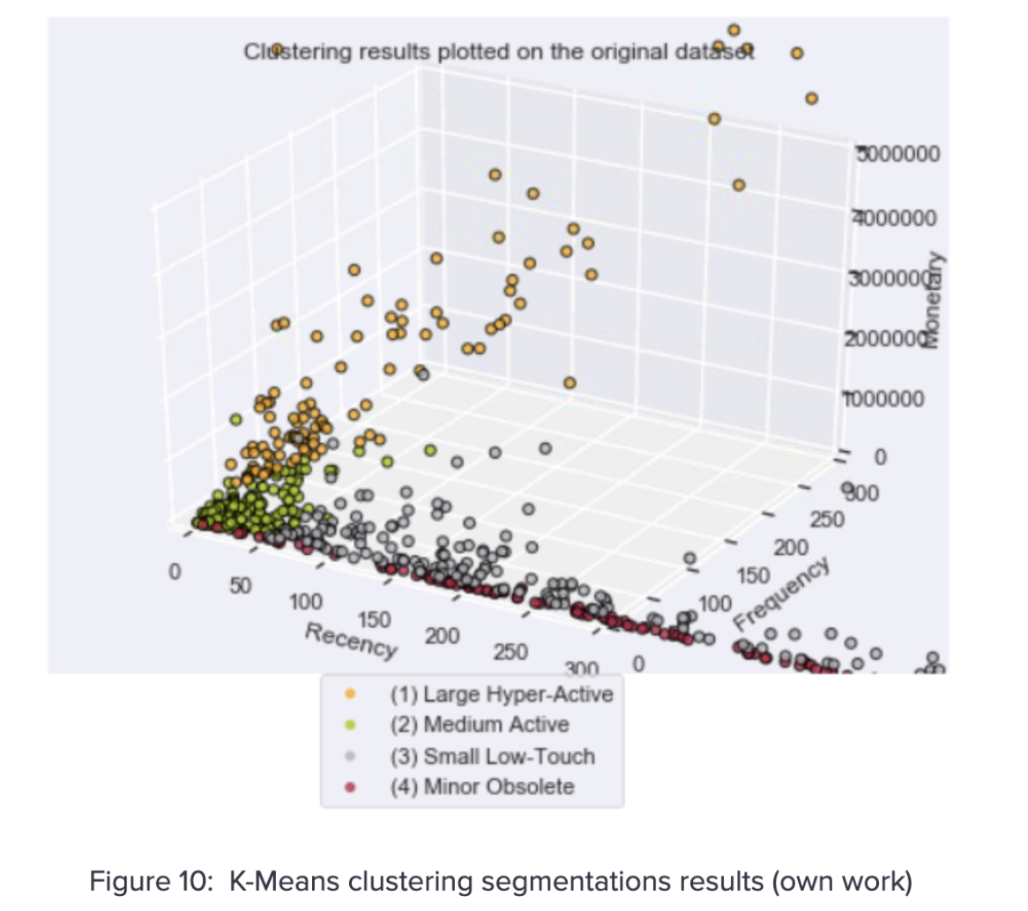
SSR - sum of squared residuals
Notes:
Vorstellung Sukanya und Sigve, Umfrage

Slide 40
SSR - sum of squared residuals
Notes:
Vorstellung Sukanya und Sigve, Umfrage

Slide 41
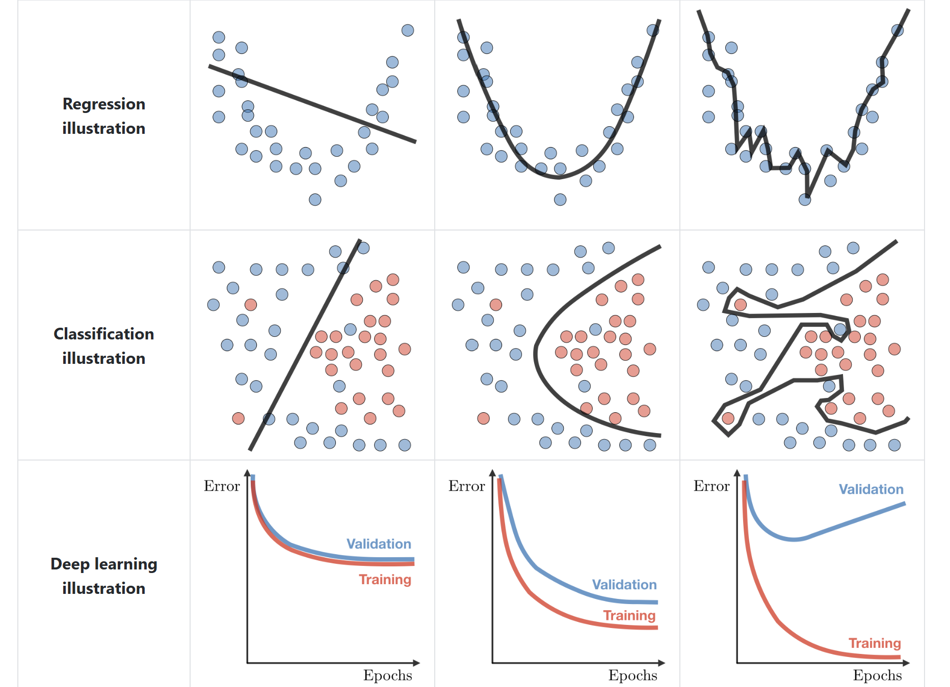
Diagnostics
High training error; training error close to test error; high bias
Training error slightly lower than test error
Very low training error; training error << test error; high variance
Underfitting
Overfitting

Slide 42
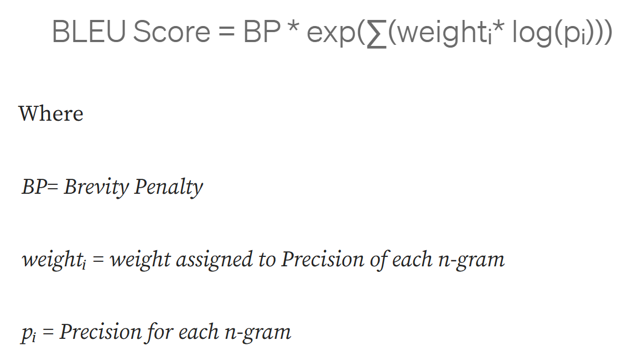
Natural Language Processing Performance
BLEU (Bilingual Evaluation Understudy): used mainly in translation tasks; estimates the overlap between the output sentence and the reference ground truth sentence.

Slide 43
Natural Language Processing Performance
METEOR: precision based metrics to measure the quality of the generated text (machine translations); evaluates matches with reference words (more robust than BLEU)
ROUGE: compares quality of the generated text with the reference text; measures recall (how many words a model can recall: % TP/(TP+TN))

Slide 44
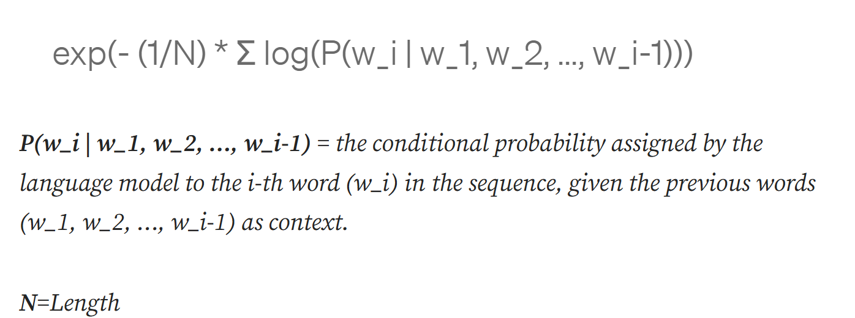
Natural Language Processing Performance
Perplexity: measures how confuse a NPL model is; derived from cross-entropy in a next word prediction task (application: dialog generation)

